Slide 1
Overview so far
Natural selection
  4 features of a population necessary and sufficient for evolution by natural selection?
Origins of the theory
  What problem was resolved by the modern synthesis (1930s)?
EAs
  How would you implement fitness proportionate selection?
Assignment 1 – simple EA, crossover vs mutation
  …

Slide 2
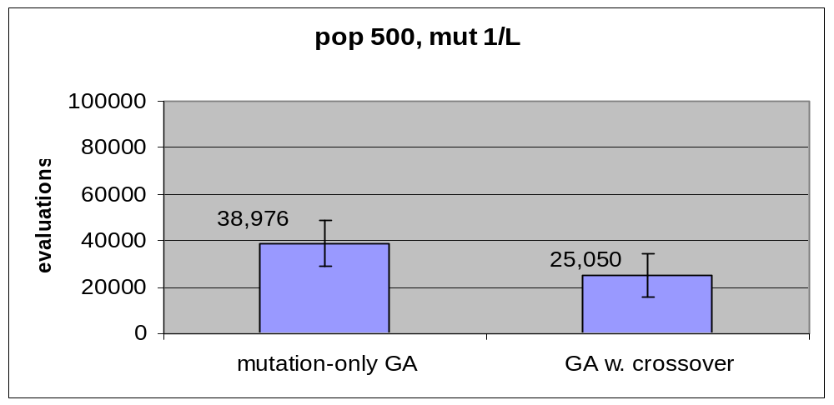
Assignment 1: main hypothesis
Is it true that a genetic algorithm with crossover finds solutions to a simple optimisation problem faster when using crossover than without crossover?
T-tests

Slide 3
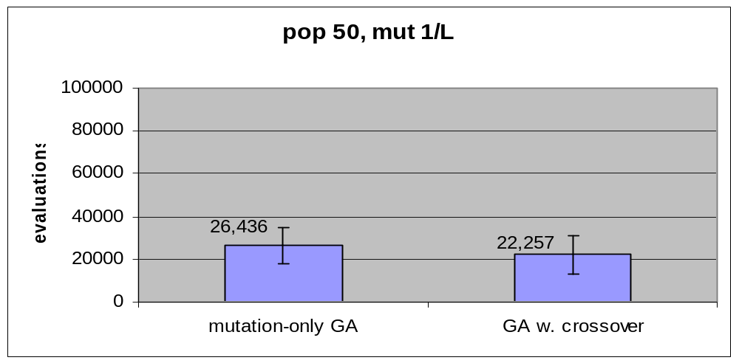
Assignment 1: Smaller population
If you use a small population is the result the same? Explain.
Bigger popn wastes more evaluations … maybe popn is a bad thing?

Slide 4
Assignment 1: Is crossover always better than mutation-only
In this problem any simple optimisation method like these will always find the optimum solution sooner or later. If the problem was a more difficult optimisation problem, do you think the answer to the hypothesis would be the same? Explain.
Basically, no - this is not always true –
i.e. Sometimes crossover makes things worse
‘No free lunch’ Wolpert and Macready 1995
More on ‘what is crossover good for?’ later in course

Slide 5
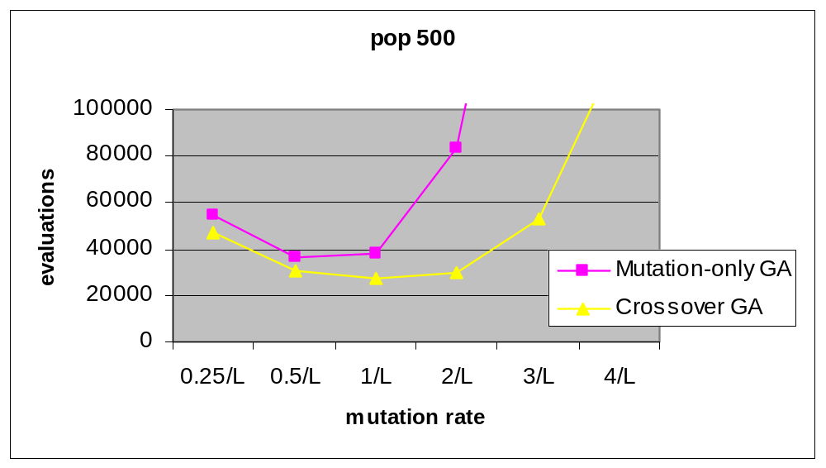
Sensitivity to mutation rate
Does using a higher mutation rate affect the result? Why?
range of mutation rates for both GAs. Does the best mutation rate for the mutation-only GA work faster than the best mutation rate for the GA with crossover?

Slide 6
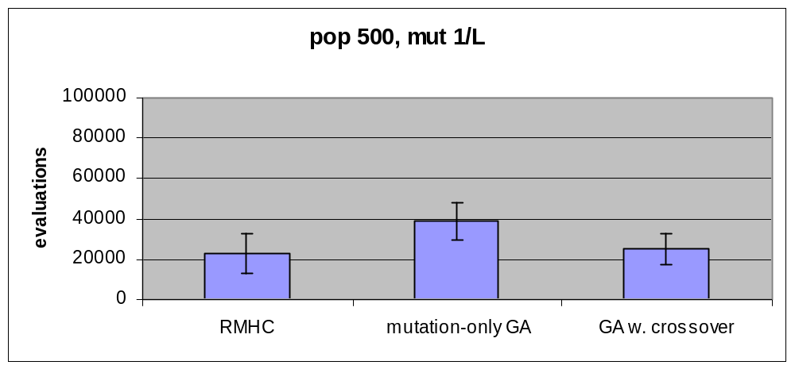
GAs vs hill-climber
How does the best of the best of the GAs compare to the speed of the mutation hill-climber?
T-tests

Slide 7
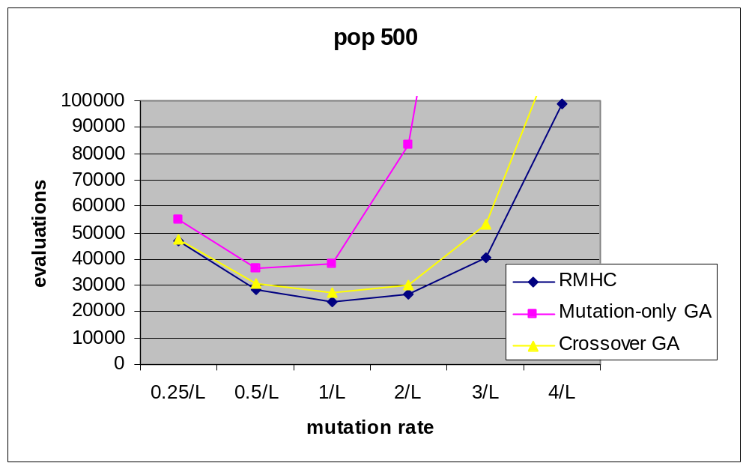
GAs vs hill-climber II
Is the GA a fancy (slightly inefficient) form of hill-climber?
What can a GA do that a hill-climber cannot?
  … a question we shall return to, but in general, an open question!

Slide 8
Evolution of Complexity?
In “methinks…” example, the exact desired ‘solution’ is known at the outset.
  Obviously not a good analogy of real engineering/optimisation problems nor natural evolution
Does it demonstrate the ‘evolution of complexity?’
What’s missing?
If it was a difficult problem (e.g. large TSP), and it found good results, we might be happier to call it a complex solution.
But, if we treat evolution as an optimisation method it necessarily has a ‘closed-ended’/finite feel to it.

